Slide 1
Establishing a Just, Learning Culture
Justin Marucci
Assignment 9
CSD 380

Slide 2
Just Culture
A Just Culture is creating a workplace that works well as a team and emphasizes fairness and accountability.
Communication – Employees are encouraged to admit and/or report mistakes when they are made to hold people accountable
Accountability for mistakes – Take accountability for your actions. Blaming people can cause problems even if the issue is not your fault, have good communication with your team to solve the issue.
Learning – Errors should be seen as an opportunity to improve, not failures
"My problem is your problem"
"Fix the problem, not the person."
“A culture of blame prevents a culture of learning.”

Slide 3
Communication
Employees may hesitate to speak up because they fear blame or punishment.
Poor communication leads to hidden mistakes, which blocks improvement.
Teams need safe spaces where people can report issues without judgment.
Clear communication helps everyone understand:
What happened
Why it happened
How the team can prevent it next time
In a just culture: “My problem is your problem.”

Slide 4
Accountability
Some employees have fear of punishment and feel embarrassed when reporting mistakes that they have made
Employees fear of punishment can cause them to hide certain issues that at the end of the day are fixable simple problems
True accountability means:
Owning your actions
Helping solve the issue
Improving the process for everyone
Management needs to create a culture where reporting issues is the norm and employees will not be "punished" or feel embarassed when reporting issues

Slide 5
Learning
Mistakes should not be looked at as failures but opportunities to learn
Learning requires:
Honest discussions
Root-cause analysis
Willingness to change workflows
Relating to the previous slide, management should expect mistakes to happen and look at it as a learning opportunity
Create a culture where it is OK to make mistakes just make sure you learn from them and move forward
“A culture of blame prevents a culture of learning.”

Slide 6
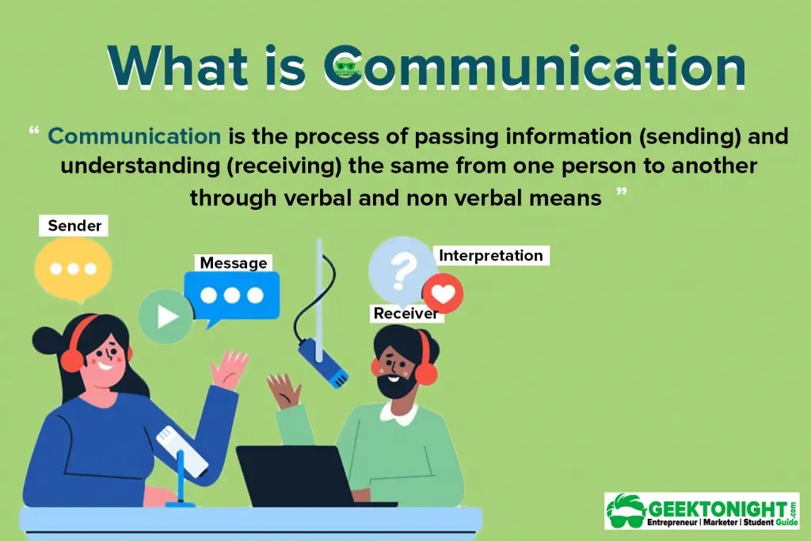



Slide 7
Sources:
Arneson, S. (2019, September 15). As long as I’m still learning, I’ll continue teaching. Arneson Communicates. https://www.arnesoncommunicates.com/blogs-and-news/as-long-as-im-still-learning-ill-continue-teaching
Atlassian. (n.d.). DevOps culture. https://www.atlassian.com/devops/what-is-devops/devops-culture Atlassian
Atlassian. (n.d.). How to run a blameless postmortem. https://www.atlassian.com/incident-management/postmortem/blameless Atlassian
Corporate Finance Institute. (n.d.). Accountability. Corporate Finance Institute. https://corporatefinanceinstitute.com/resources/management/accountability/
Geraghty, T. (2023, March 20). The importance of psychological safety in DevOps teams. DevOps Agile Skills Association (DASA). https://www.dasa.org/blog/the-importance-of-psychological-safety-in-devops-teams/ DASA
Lunney, J., & Lueder, S. (2016). Postmortem culture: Learning from failure. In B. Beyer, C. Jones, J. Petoff, & N. R. Murphy (Eds.), Site reliability engineering: How Google runs production systems. O’Reilly Media. https://sre.google/sre-book/postmortem-culture/ Google SRE
OpenAI. (2025). ChatGPT (version 5.1) [Large language model]. https://chat.openai.com/
Seelam, J. (2025, August 6). From incidents to insights: The power of blameless postmortems. DevOps.com. https://devops.com/from-incidents-to-insights-the-power-of-blameless-postmortems/
What Is Communication? Importance, Forms, Nature. (n.d.). Geektonight. https://www.geektonight.com/what-is-communication/

